Slide 1
Availability of ACCESS-C Forecast System to the National Research Community
www.cawcr.gov.au
Wenming LU, Mike NAUGHTON
lwenming@bom.gov.au
mjn@bom.gov.au
ESM, Nov 26 2013

Slide 2
ACCESS City Forecast System-Background
ACCESS City Forecast system, aka ACCESS-C, is the highest resolution operational numerical weather prediction system in the Bureau of Meteorology (BOM).
ACCESS-C has been running operationally since 2010
ACCESS-C covers 5 domains, South-east Queensland (Brisbane), Sydney, VicTas, Adelaide and Perth
ACCESS-C runs out to 36 hours and nest within ACCESS-Regional, i.e., the initial and boundary conditions are interpolated from the larger ACCESS-R analyses and forecasts

Slide 3
ACCESS-C upgraded in August 2013
The nested ACCESS-R upgraded from 37km to 12km
ACCESS-C horizontal resolution is increased from 0.050 to 0.036 degrees (5km to 4km)
ACCESS-C vertical resolution is increased from 50 levels to 70
ACCESS-C runs 4 times daily, 00, 06, 12 and 18Z instead of twice daily, 00 and 12Z
Darwin domain is added and other domains may be adjusted

Slide 4
ACCESS-C Domains in Detail
DOMAIN | ABBR. | LAT. RANGE | LON. RANGE | GRID
Brisbane | BN | -31.00S, -22.04S | 148.00E, 156.03E | 250x224
Sydney | SY | -38.00S, -29.98S | 147.00E, 155.03E | 224x224
VicTas | VT | -46.00S, -33.04S | 139.00E, 150.99E | 362x334
Adelaide | AD | -39.50S, -29.53S | 132.00E, 141.98E | 278x306
Perth | PH | -37.00S, -28.04S | 112.00E, 122.98E | 250x306
Darwin | DN | -16.00S, -7.97S | 128.50E, 139.98E | 224x320

Slide 5

ACCESS-C For NeCTAR
As part of the NeCTAR Climate and Weather Science Laboratory, ACCESS-C standard suite has been installed on NCI HPC (raijin)
System Files
Rose Suite
raijin
accessdev
Source Code
Data

Slide 6
ACCESS-C For NeCTAR
/g/data/access/AccessModelExperimentLibrary/aps1_access_c/aps1_access_c.raijin -> System files, including executable, ancillary, namelists, configurations, environment settings etc.
/g/data/access/AccessModelExperimentLibrary/aps1_access_c/aps1_access_c.accessdev -> rose and cylc suite files
/g/data/access/AccessModelExperimentLibrary/aps1_access_c/src -> source code
/g/data/access/AccessModelExperimentLibrary/aps1_access_c/data -> input data => dump and pi files and output data => initial and boundary conditions, forecast data for reference

Slide 7
ACCESS-C: How-To on NCI infrastructure
There are wikis
https://trac.nci.org.au/trac/access/wiki/APS1_ACCESS_C
https://trac.nci.org.au/trac/access/wiki/APS1_ACCESS_C_new
Installation
/g/data/access/AccessModelExperimentLibrary/aps1_access_c/install_aps1_access_c.ksh

Slide 8
ACCESS-C: How-To on NCI infrastructure
Steps done by installation
Copy aps1_access_c.raijin to your raijin:$HOME/aps1_access_c
Copy aps1_access_c.accessdev your accessdev:$HOME/roses/aps1_access_c
Copy the source code to your data folder
After installation
Set up the environment on raijin, .bashrc
module use ~access/modules
module load rose cylc
Go to accessdev:$HOME/roses/aps1_access_c, and run
rose suite-run

Slide 9
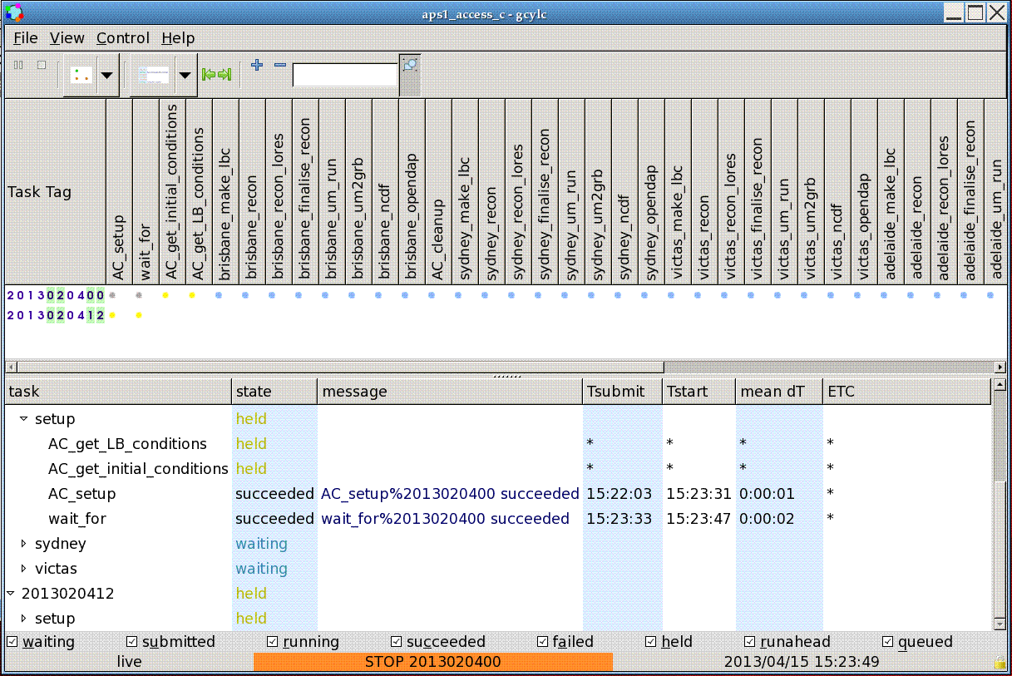
ACCESS-C: How-To on NCI infrastructure

Slide 10
ACCESS-C Case Study: BN Heavy Rain

Slide 11
ACCESS-C Case Study: AD Hot Weather

Slide 12
ACCESS-C Case Study: SY Fire Weather

Slide 13
ACCESS-C: Other/Future Work
In the event of high-impact weather, it is desirable to run either
Domain on demand: on a region of interests which is not covered by 6 regular domains
Higher resolution forecasting to provide more detailed forecast data

Slide 14
ACCESS-C: SY Fire 1.5km Resolution

Slide 15

Thank you
The Centre for Australian Weather and Climate Research
A partnership between CSIRO and the Bureau of Meteorology
Mike NAUGHTON
Wenming LU
mjn@bom.gov.au
lwenming@bom.gov.au
Web: www.cawcr.gov.au
Thank you
www.cawcr.gov.au

